Slide 1
INSIDER THREAT DETECTION - USING FEATURE ENGINEERING AND SAMPLING TECHNIQUES
JEYA KRISHNA CHANDU AKULA
ANU DEEPIKA DEVARA

Slide 2
INSIDER THREATS
Insider threats exploit authorized access to harm organizations.
Trusted insiders can sabotage, steal, disrupt, or attack from within.
No organization is immune from risky individuals within.

Slide 3
DATASET
CMU’s CERT dataset v4.2
Diverse log and event data mirrors real environments.
Simulates realistic insider threat scenarios.
Enables robust research with focus on privacy.
Captures user activities from logons to file access.

Slide 4
DATASET:
File | Feature Description
logon.csv (logon/logoff activities) | ID,date, user, PC, activity
device.csv (external storage device usage) | ID,date, user, PC, activity (connect/disconnect)
email.csv (email traffic) | ID,date, user, PC, to, cc, bcc, form, size, attachment count, content
file.csv (file operations) | ID,date, user, PC, filename, content

Slide 5
PREVIOUS WORKS
Accuracies of Previous Models:
Authors | Model Used | Accuracy
Noever | Random Forest | 90%
Noever | Random Forest with Randomization | 94%
Meng F. | LSTM - RNN | 93.85%
Lin L. | DBN - OCSVM | 87%
Vasileios Koutsouvelis | Convolutional Neural Networks | 90%
Zhou Z.H. | Graph Convolutional Networks | 94.5%

Slide 6
OUR RESEARCH GOAL
Dataset imbalance: More non-malicious records.
Previous works lacked balancing techniques.
Utilized SMOTE, ADASYN, SMOTE+ENN, SMOTE+TOMEK LINKS.
Aim: Balance data for ML and DL classifiers.
Evaluate accuracy post-balancing techniques.
Version | Employees | Insiders | Activities
r4.2 | 1000 | 70 | 32,770,227

Slide 7
FEATURE EXTRACTION
Derived 17 features from user activities, file types, logon, and email transactions.
Extracted relevant features, unified into a dataframe.
Aggregated features with userID and counted frequencies.
Identified malicious/non-malicious features based on predefined criteria.
Target column: '1' for malicious, '0' for non-malicious users.

Slide 8
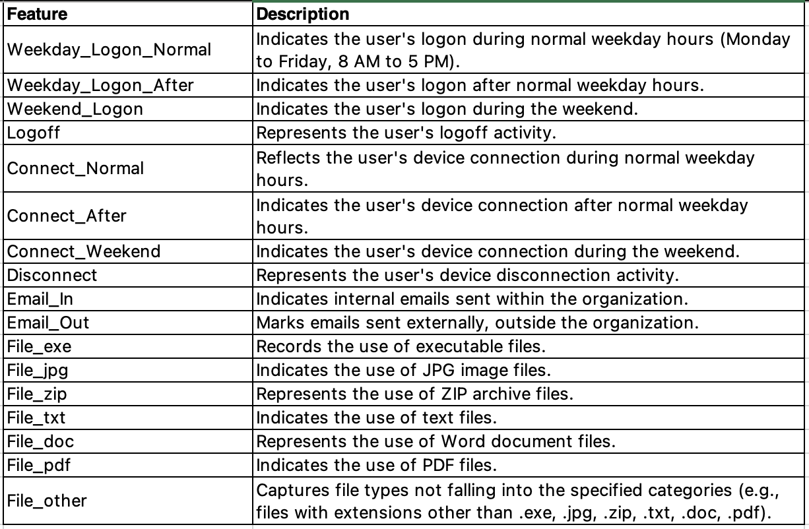

Slide 9
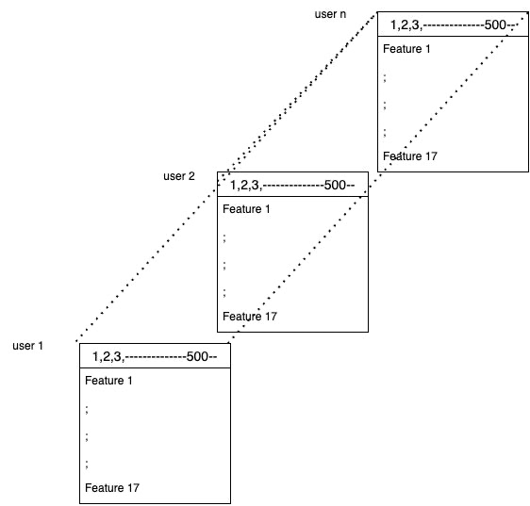
VECTORIZATION
Vectorization transforms raw log data for structured analysis.
Captures temporal dynamics of user behavior.
Conversion to a 2D array yields 9000 features per user in the dataframe.

Slide 10
SAMPLING TECHNIQUES
To balance the target classes.
Four techniques were used:
SMOTE(Synthetic Minority Oversampling Technique)
ADASYN(Adaptive Synthetic Sampling Approach)
SMOTE+ENN(Edited Nearest Neighbour)
SMOTE+Tomek Links

Slide 11
CLASSIFIERS
Selected models: Logistic Regression, SVC, Random Forest, AdaBoost, Isolation Forest, and CNN.
Chosen for handling imbalanced data with skewed class distributions.
Models offer adaptability, flexibility, and robust performance.
Tailored for effective analysis in scenarios with imbalanced datasets.

Slide 12
METRICS
Models are evaluated using the following metrics:
Accuracy
Precision
Recall
F1 Score

Slide 13
EXPERIMENTAL RESULTS
SMOTE:
Model | Accuracy | Precision | Recall | F1-Score
Logistic Regression | 0.95 | 0.94 | 0.87 | 0.90
Random Forest | 0.90 | 0.83 | 0.79 | 0.81
SVC | 0.95 | 0.90 | 0.94 | 0.92
AdaBoost | 0.87 | 0.80 | 0.70 | 0.75
Isolation Forest | 0.82 | 0.93 | 0.40 | 0.55
CNN | 0.94 | 0.95 | 0.84 | 0.89

Slide 14
EXPERIMENTAL RESULTS
ADASYN:
Model | Accuracy | Precision | Recall | F1-Score
Logistic Regression | 0.94 | 0.91 | 0.89 | 0.88
Random Forest | 0.88 | 0.81 | 0.77 | 0.78
SVC | 0.94 | 0.92 | 0.87 | 0.90
AdaBoost | 0.87 | 0.81 | 0.73 | 0.76
Isolation Forest | 0.83 | 0.78 | 0.56 | 0.65
CNN | 0.96 | 0.93 | 0.94 | 0.94

Slide 15
EXPERIMENTAL RESULTS
SMOTE+Tomek Links:
Model | Accuracy | Precision | Recall | F1-Score
Logistic Regression | 0.95 | 0.95 | 0.92 | 0.93
Random Forest | 0.86 | 0.79 | 0.69 | 0.73
SVC | 0.92 | 0.92 | 0.84 | 0.86
AdaBoost | 0.85 | 0.77 | 0.73 | 0.73
Isolation Forest | 0.80 | 0.77 | 0.40 | 0.51
CNN | 0.95 | 0.95 | 0.84 | 0.89

Slide 16
EXPERIMENTAL RESULTS
SMOTE+ENN:
Model | Accuracy | Precision | Recall | F1-Score
Logistic Regression | 0.93 | 0.90 | 0.87 | 0.88
Random Forest | 0.87 | 0.81 | 0.69 | 0.74
SVC | 0.93 | 0.94 | 0.89 | 0.91
AdaBoost | 0.85 | 0.80 | 0.66 | 0.71
Isolation Forest | 0.77 | 0.76 | 0.30 | 0.40
CNN | 0.95 | 0.95 | 0.84 | 0.89

Slide 17
COMPARATIVE ANALYSIS
For CERT Dataset v4.2:
Authors | Model Used | Accuracy
Noever | Random Forest | 90%
Noever | Random Forest with Randomization | 94%
Meng F. | LSTM - RNN | 93.85%
Lin L. | DBN - OCSVM | 87%
Vasileios Koutsouvelis | Convolutional Neural Networks | 90%
Zhou Z.H. | Graph Convolutional Networks | 94.5%
Our Model | ADASYN + CNN | 96%

Slide 18
CONCLUSION
Balanced class distribution using sampling techniques for improved accuracy in detecting malicious behavior.
Found ADASYN with CNN classification most effective, noting challenges in retraining for system updates and new users.
Proposed future research: explore alternative datasets, engage in real-world data-sharing, and investigate DFS application in diverse domains.

Slide 19
THANK YOU
Q&A

